Slide 1


Induction Briefing
The Business Model Actualisation Platform
Student Version
Induction and Situation 1 Briefing

Slide 2
BMAP Overview
Induction Briefing
A Three-Step Process
  Situation
  Challenge
  Solution
© Copyright MBA Global AML 2017

Slide 3
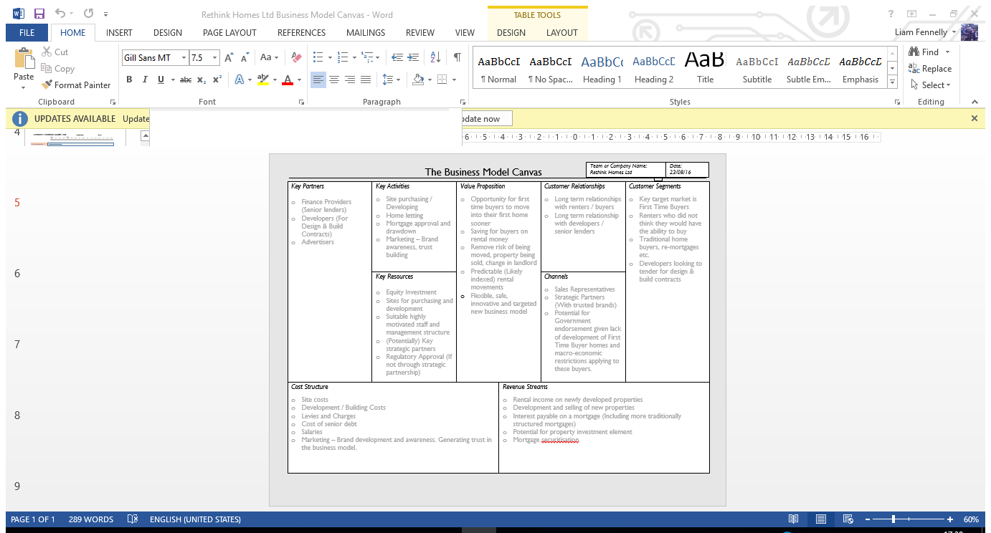
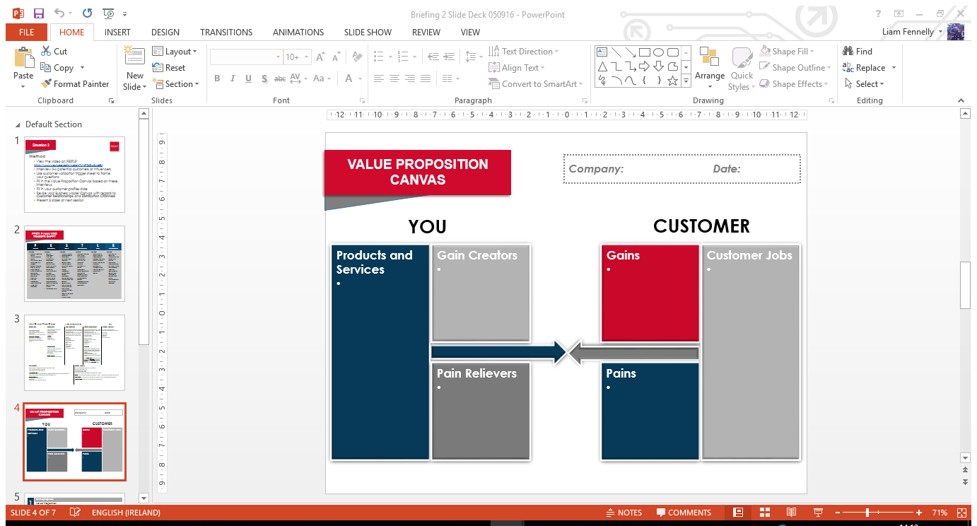

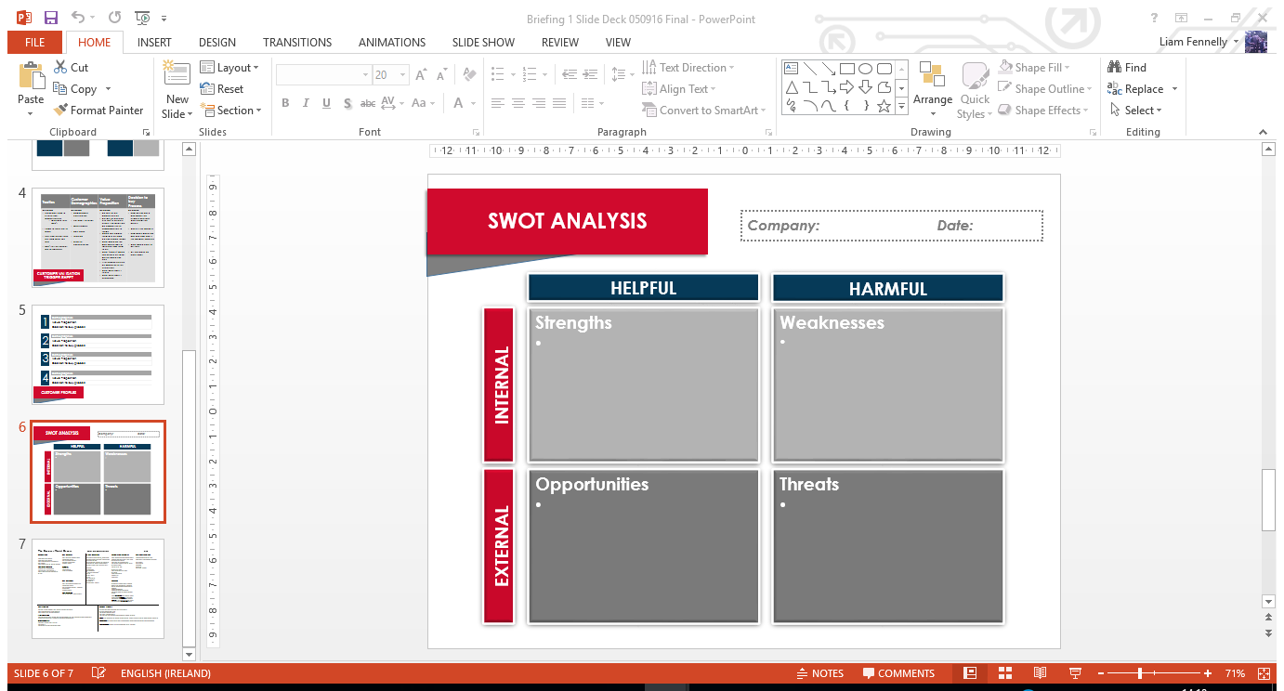
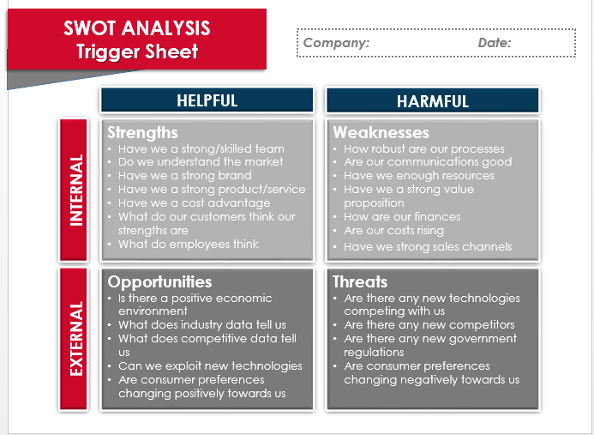
Tools and
Trigger Sheets
Induction Briefing
© Copyright MBA Global AML 2017

Slide 4
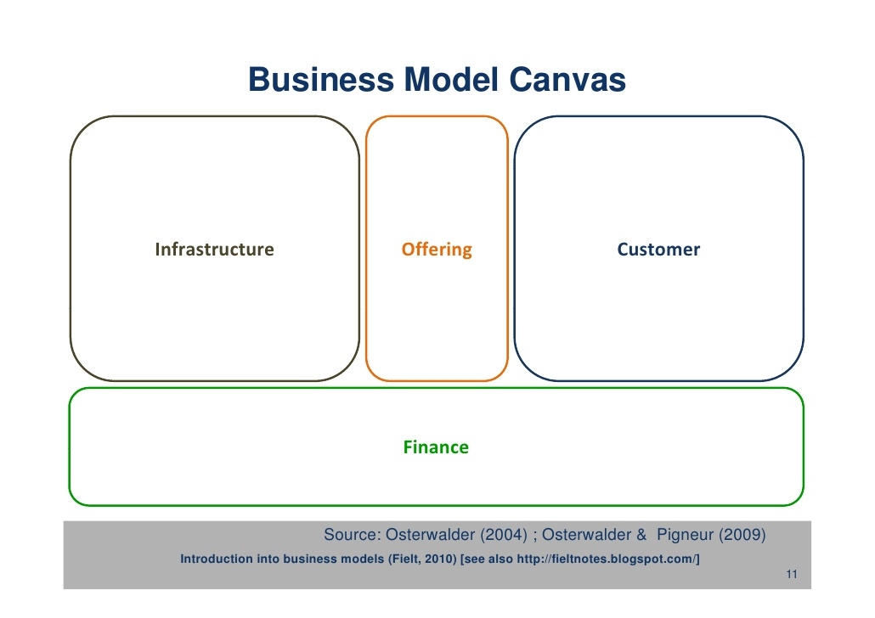
The Business Model Canvas Basics

Slide 5
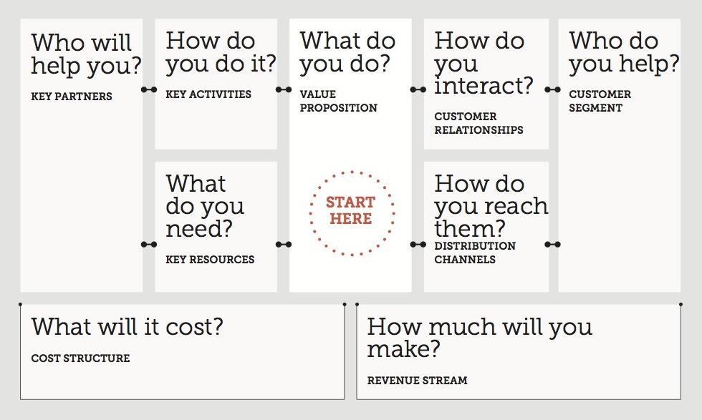
The Business Model Canvas Explained
✓
✓
✓
✓
✓
✓
✓
✓

Slide 6
The Business Model Canvas
© Copyright MBA Global AML 2017

Slide 7
Induction
Induction Briefing
Choose your business idea.
  Suggestions as follows:
Coffee Shop
Shoe Shop
PR Company
Gymnasium
Estate Agency
Service Company
  Painting
  Plumbing
  Electrical
  Joinery
Website
  Information
  Selling Goods
  Selling Services
App
Computer Game
New Product
© Copyright MBA Global AML 2017

Slide 8
Method
Situation 1
Briefing
Download the Business Model Canvas trigger sheet and the Customer Questionnaire.
© Copyright MBA Global AML 2017

Slide 9
Situation 1
Briefing
© Copyright MBA Global AML 2017

Slide 10
Method
Situation 1
Briefing
Download the Business Model Canvas trigger sheet and the Customer Questionnaire.
Interview 3-4 potential customers and summarise them in the Customer Profiles slide
Download the presentation slide deck for Situation 1
View the video link at the end of this presentation – Gore Fabrics’ Business Model Canvas
© Copyright MBA Global AML 2017

Slide 11
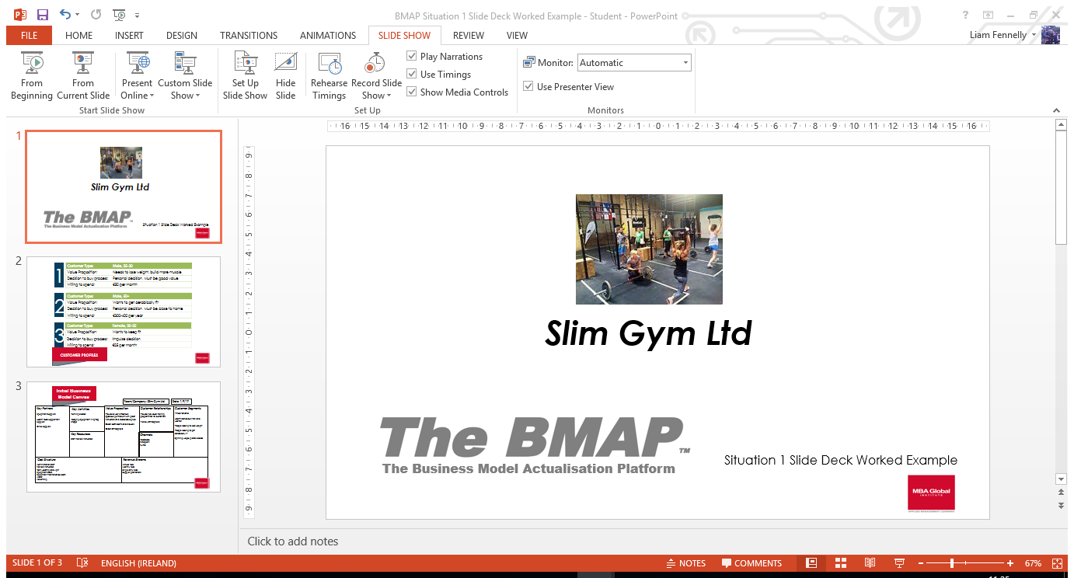
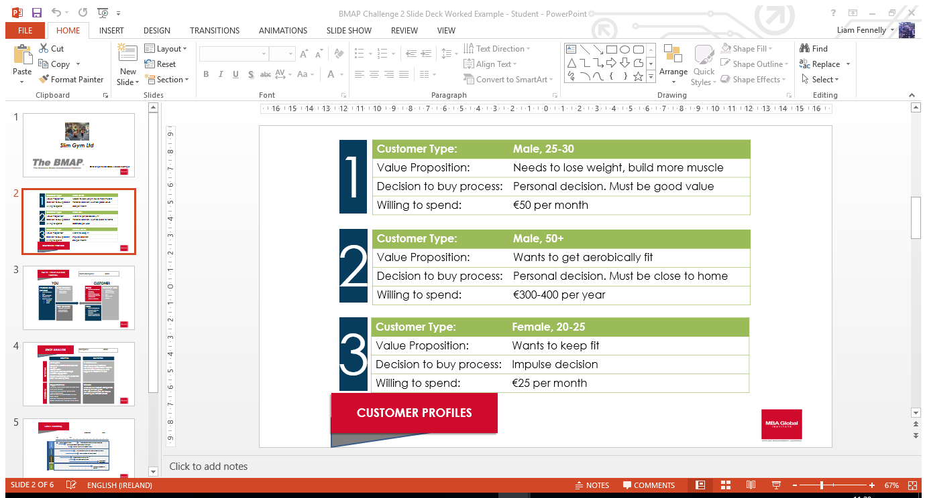
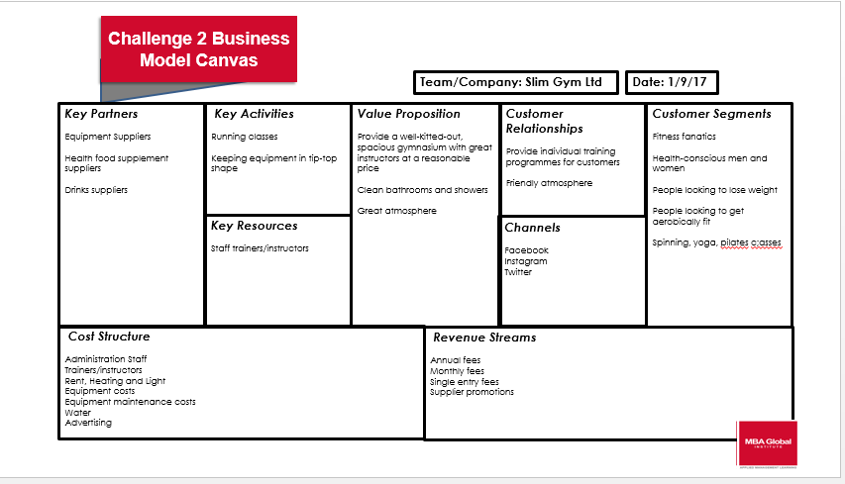
Situation 1 Briefing
The Business Model Actualisation Platform
Situation 1
© Copyright MBA Global AML 2017

Slide 12
Situation 1
Briefing
The Business Model Canvas:
https://www.youtube.com/watch?v=G1lHCP3gTQc
© Copyright MBA Global AML 2017

